Slide 1

Principle 2 Money comes from work

Slide 2
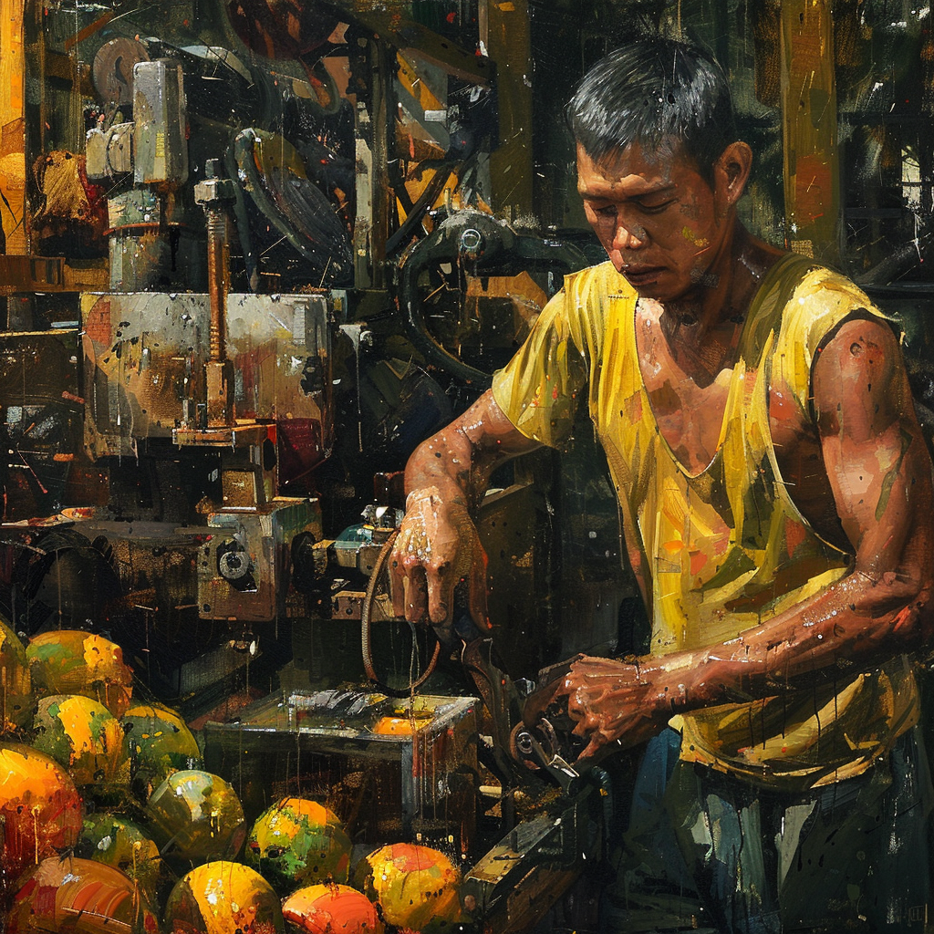
Toy is working hard
So he can provide for his family

Slide 3
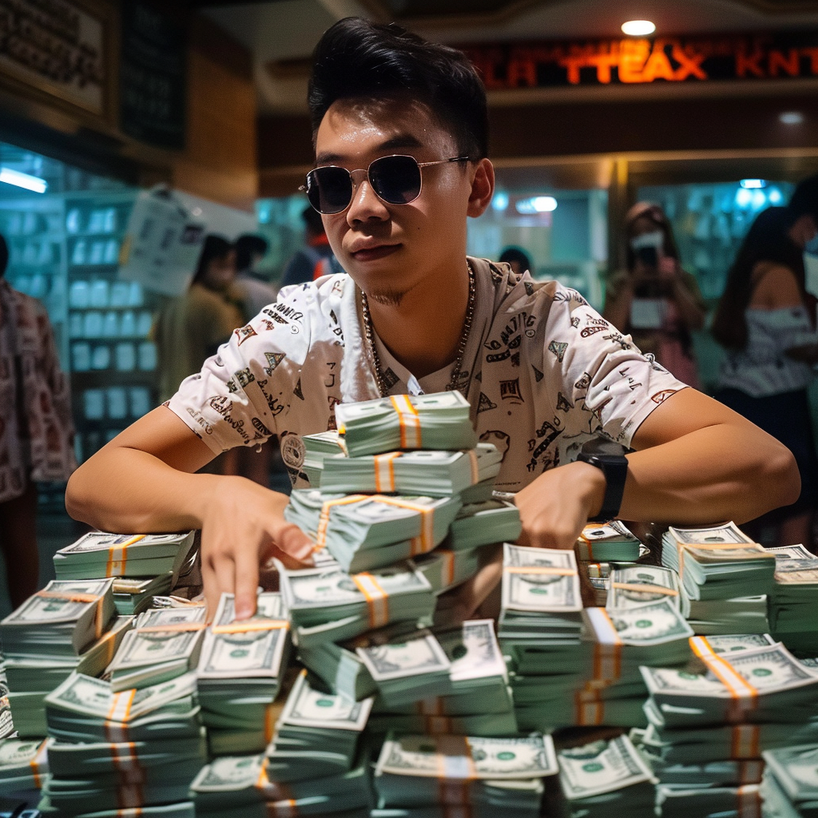
Bong doesn’t need to work
He just get the interests of his money

Slide 4
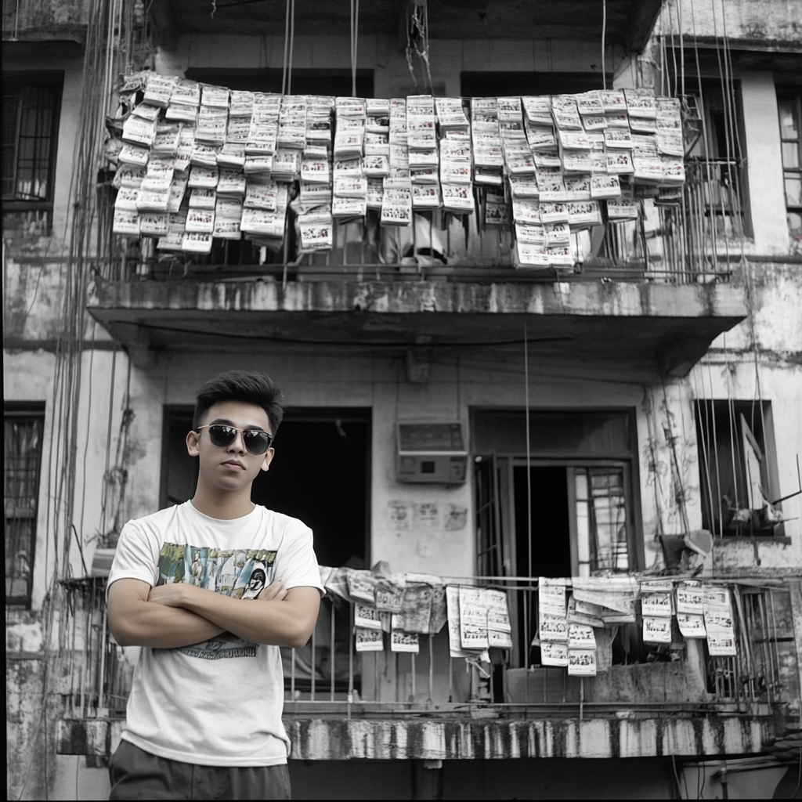
He collects his rents

Slide 5
You think it is fair ?

Slide 6
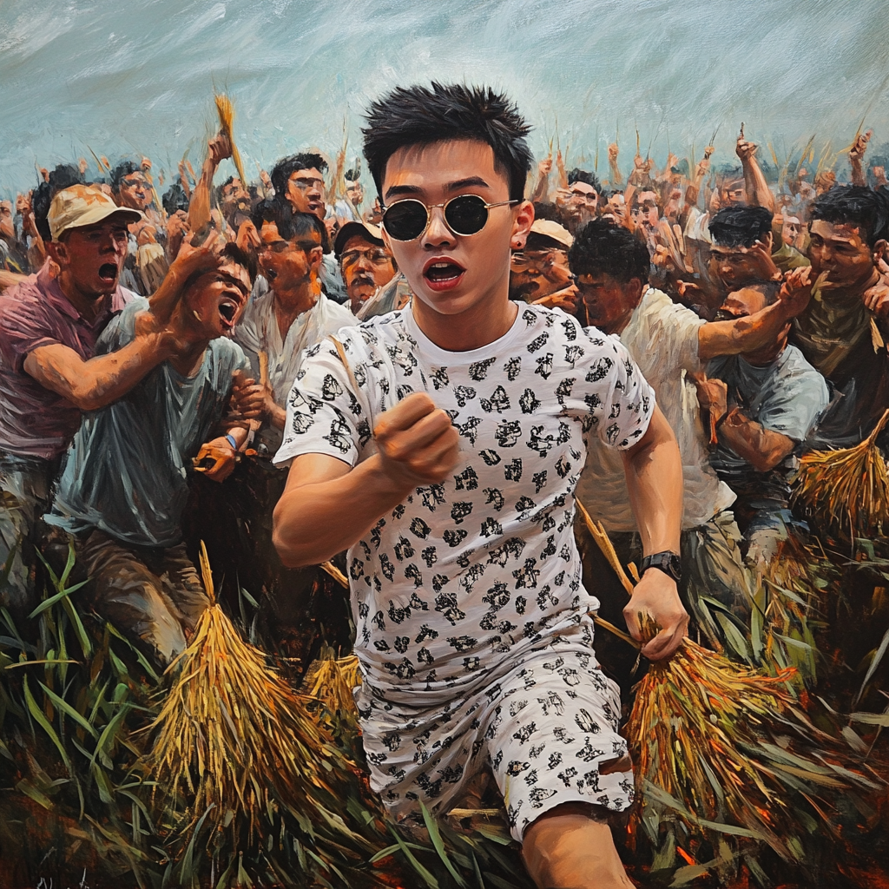
Of course No it is not !

Slide 7

Join la Liga !
Do you really think justice can happen without you ?
la-liga.ph

